Slide 1
Notation for Parallel Thoughts
Morten Kromberg, CXO
Dyalog Ltd
FunctionalConf 2016 Bangalore October 15th, 2016

Slide 2
John Backus’ Turing Award Lecture (1977):
We owe a great debt to Kenneth Iverson for showing us that there are programs that are neither word-at-a-time nor dependent on lambda expressions, and for introducing us to the use of new functional forms.

Slide 3
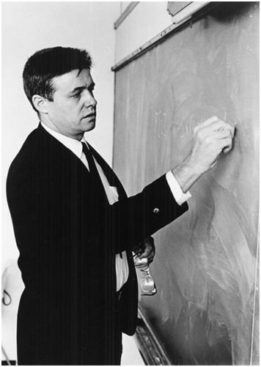
Notation as a Tool of Thought
From Kenneth Iverson’s 1979 Turing Award Lecture:
By relieving the brain of all unnecessary work, a good notation sets it free to concentrate on more advanced problems, and in effect increases the mental power of the race.
A.N. Whitehead (1861-1947)
The quantity of meaning compressed into small space by algebraic signs, is another circumstance that facilitates the reasonings we are accustomed to carry on by their aid.
Charles Babbage (1791 – 1871)

Slide 4










A Programming Language (for Math)
a×b
Mat1 +.× Mat2
Problems:
- Wide variety of syntactical forms
- Strange and inconsistent precedence rules - Things get worse when you deal with matrices See http://www.jsoftware.com/papers/EvalOrder.htm
*x
f g x
x÷y
(3○x)*2
b⍟a
+/4×⍳6 ×/4×⍳6
a*÷n
(2×a)÷⍨(-b)(+,-)0.5*⍨(b*2)-4×a×c

Slide 5
Reading APL…
(2×a)÷⍨
2 times a divided into…
(2×a)÷⍨(-b)(+,-)
… -b plus or minus …
(2×a)÷⍨(-b)(+,-)0.5*⍨
… the square root of …
(2×a)÷⍨(-b)(+,-)0.5*⍨(b*2)-4×a×c
… b squared minus 4 a c ...

Slide 6
Syntax of APL
Syntactical Form | Example | Result
array | 1 3.1415 1.2E18
function argument | ⍳ 6 | 1 2 3 4 5 6
left-arg function right-arg | 1 2 3 × 1 10 100 | 1 20 300
operand operator | ×/ 1 2 3 4 5 6 2 +/ 1 2 3 4 5 6 | 720 3 5 7 9 11
left-opnd operator right-opnd | 1 0 2 +.× 1 2 3 | 7
array[indices] | 'ABCDEF'[2 5 5 6] | BEEF
Notes:
Demo “Syntaxes”

Slide 7
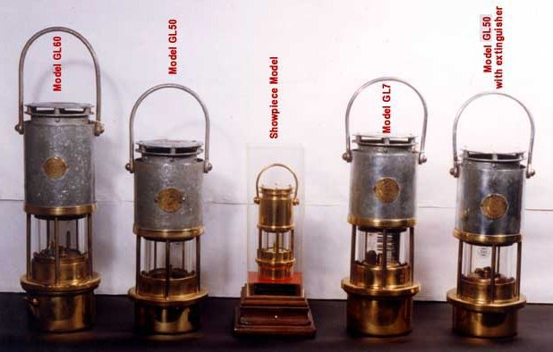
Comments
The ”lamp” symbol (⍝) indicates the beginning of a comment:
2×3 ⍝ two times three
6

Slide 8
Scalar Functions
1 2 3 + 4 5 6 ⍝ addition 5 7 9
10 20 30 > 25 ⍝ greater than 0 0 1
1 2 3 ⌈ 3 2 1 ⍝ maximum 3 2 3
10 × 2 3 ⍴ ⍳ 6 ⍝ scalar extension 10 20 30 40 50 60
? 6 6 6 6 ⍝ roll 4 3 5 4

Slide 9
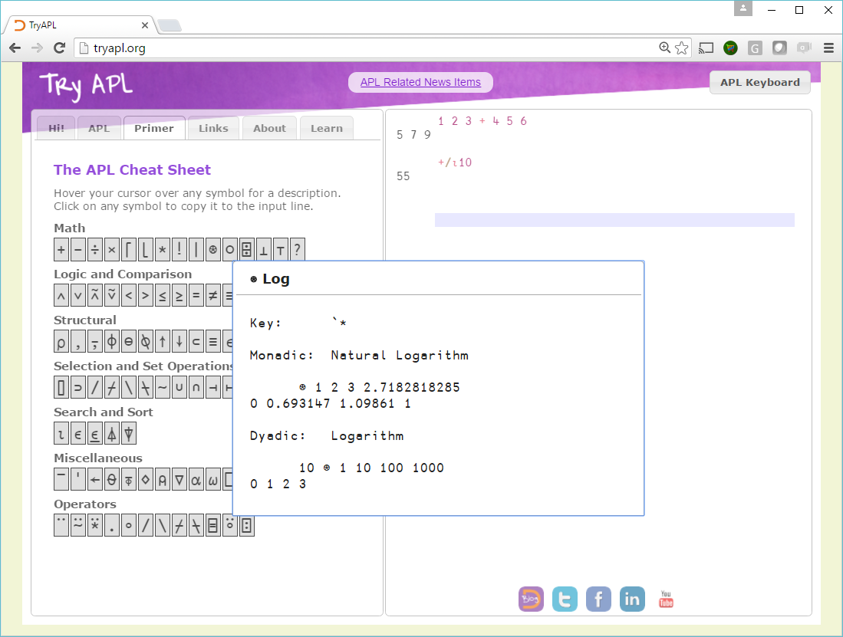

Slide 10
Reduction (f/ or f⌿ or f/[n])
mat ← 3 4 ⍴ ⍳12
×/mat
1 | 2 | 3 | 4
5 | 6 | 7 | 8
9 | 10 | 11 | 12
24
1680
11880
×⌿mat
45 | 120 | 231 | 384

Slide 11
Scan (f\ or f⍀ or f\[n])
mat ← 3 4 ⍴ ⍳12
+\mat
1 | 2 | 3 | 4
5 | 6 | 7 | 8
9 | 10 | 11 | 12
1 | 3 | 6 | 10
5 | 11 | 18 | 26
9 | 19 | 30 | 42
+⍀mat
1 | 2 | 3 | 4
6 | 8 | 10 | 12
15 | 18 | 21 | 12

Slide 12






Outer Product (∘.f)
⍺f⍵ for all combinations of items from left & right
vec1 ∘.x vec2
1 | 2
10 | 100 | 1000

Slide 13
Inner Product (f.g)
f/ row g col for all combinations of rows left, cols right.
m1
m2
1 | 2 | 0
¯1 | 0 | 3
¯1 | 1
0 | 2
¯1 | 0
m1 +.× m2
+/ 1 2 0 × 1 2 0
¯1 | 5
¯2 | ¯1
(+.× is the regular “dot product”)

Slide 14
Inner Product (f.g)
m1
m2
1 | 2 | 0
¯1 | 0 | 3
¯1 | 1
0 | 2
¯1 | 0
m1 ∧.= m2
∧/ 1 2 0 = 1 2 0
0 | 1
0 | 0
(∧.= is “are any identical”?)

Slide 15
Selected Mixed Functions 1/4
mat ← 3 4 ⍴ ⍳12
Rotate: ⌽ ⊖ and ⌽[n]
2 0 ¯1⌽mat
1 | 2 | 3 | 4
5 | 6 | 7 | 8
9 | 10 | 11 | 12
3 | 4 | 1 | 2
5 | 6 | 7 | 8
12 | 9 | 10 | 11
0 1 0 ¯1⊖mat
1 | 6 | 3 | 12
5 | 10 | 7 | 4
9 | 2 | 11 | 8

Slide 16
Selected Mixed Functions 2/4
Take ↑ and Drop ↓
mat ← 3 4 ⍴ ⍳12
¯2 2↑mat
1 | 2 | 3 | 4
5 | 6 | 7 | 8
9 | 10 | 11 | 12
5 | 6
9 | 10
1↓mat
5 | 6 | 7 | 8
9 | 10 | 11 | 12

Slide 17
Selected Mixed Functions 3/4
Transpose ⍉
mat ← 3 4 ⍴ ⍳12
⍉mat
1 | 2 | 3 | 4
5 | 6 | 7 | 8
9 | 10 | 11 | 12
1 | 5 | 9
2 | 6 | 10
3 | 7 | 11
4 | 8 | 12
1 1⍉mat
1 | 6 | 11

Slide 18
Selected Mixed Functions 4/4
IndexOf ⍳
3 1 4 1 5 9 ⍳ 1 2 3 2 7 1
Grade (Up) ⍋
⍋3 1 4 1 5 9
2 4 1 3 5 6
{⍵[⍋⍵]}3 1 4 1 5 9 ⍝ index by grade
1 1 3 4 5 9

Slide 19
Summary: Basic [Parallel] Forms
The following forms have existed since the beginning:
Scalar functions: +-×÷| *⍟ ⌈⌊ <≤=≥>≠ ∧∨ ⍲⍱ ~ ○! ?(roll)
Reduction: /⌿ and Scan: \⍀
Outer Product: ∘.f
Inner Product (rows-left vs cols-right): f.g and ⊥
“Mixed”: ⌹⊤ ⍴,↑↓ ⍳∊⍒⍋ ⌽⍉⊖ ?(deal)

Slide 20
1982: Nested Arrays
APL2: Any item of an array can be another array
Scalar functions “pervade”:
(1 2 3) 10 × (4 5 6) (7 (8 9)) ┌───────┬──────────┐ │4 10 18│┌──┬─────┐│ │ ││70│80 90││ │ │└──┴─────┘│ └───────┴──────────┘

Slide 21
Each Operator (¨)
The “Each” operator ¨ maps “non-scalar” functions.
For example, +/ reduces vectors so:
+/ (4 5 6) (7 8 9) ⍝ ←→ (4 5 6)+(7 8 9) 11 13 15
But +/¨ (plus reduce each) will apply to each item individually:
+/¨ (4 5 6) (7 8 9) ⍝ ←→ (4+5+6) (7+8+9) 15 24

Slide 22
“Function Trains”
“Atop”: (f g) ⍺ (f g) ⍵ ←→ f (⍺ g ⍵) 10000 (? ⍴) 6 ⍝ Roll 10000 dice w/out 10000 element temp array
“Fork”: (f g h) (f g h) ⍵ ←→ (f ⍵) g (h ⍵) (f + h) ⍵ ←→ (f ⍵) + (h ⍵) (+⌿ ÷ ≢) ⍵ ←→ (+/⍵) ÷ (≢ ⍵) ⍝ mean is sum ÷ count
⍺ (f g h) ⍵ ←→ (⍺f⍵) g (⍺h⍵) 1 (+ , -) 0.1 ⍝ (1+0.1),(1-0.1) or 1 ± 0.1 1.1 0.9
Tines of a fork can be computed in parallel, and Trains allow creation of more efficiently parallelisable units

Slide 23
User-defined Functions
Lambdas, aka “dfns” provide a lexically scoped, functional form of functions in APL.
Alternative to procedural style of coding from 1966 APL.
plusdouble←{⍺+2×⍵} ⍝ left arg + two times right
fibonacci←{ ⍝ Tail-recursive Fibonacci.
⍺←0 1 ⍝ Default left argument
⍵=0:⍬⍴⍺ ⍝ If ⍵=0, return 1st item of ⍺
(1↓⍺,+/⍺)∇ ⍵-1 ⍝ Tail recursion
}

Slide 24
Power Operator
Apply a function a fixed number of times, or until the right operand function tells you to stop. 2 (+ ⍣ 3) 3 ⍝ Add 2 three times 9 twice←⍣2 ⍝ Bind one operand; 2 +twice 3 ⍝ twice is a monadic opr 7 ({1+÷⍵}⍣≡)1 ⍝ … until f^{n} ≡ f^{n-1} 1.618033989
Parallelizable for selected operand functions like transitive closure ∨.∧⍨⍣≡

Slide 25
Parallelism: Basic Primitives
Selected scalar functions are automatically threaded on floats (DOUBLE & IEEE-754 Decimal QUAD in modern Dyalog APL): cmpx 'a1+b1' 'ap+bp' ⍝ + on DOUBLES doesn’t speed up
a1+b1 → 3.4E¯5 | 0% ⎕⎕⎕⎕⎕⎕⎕⎕⎕⎕⎕⎕⎕⎕⎕⎕⎕⎕⎕⎕⎕⎕⎕⎕⎕⎕⎕⎕⎕⎕⎕⎕
ap+bp → 3.1E¯5 | -9% ⎕⎕⎕⎕⎕⎕⎕⎕⎕⎕⎕⎕⎕⎕⎕⎕⎕⎕⎕⎕⎕⎕⎕⎕⎕⎕⎕⎕
cmpx 'a1÷b1' 'ap÷bp'
a1÷b1 → 4.9E¯5 | 0% ⎕⎕⎕⎕⎕⎕⎕⎕⎕⎕⎕⎕⎕⎕⎕⎕⎕⎕⎕⎕⎕⎕⎕⎕⎕⎕⎕⎕⎕⎕⎕⎕
ap÷bp → 3.3E¯5 | -34% ⎕⎕⎕⎕⎕⎕⎕⎕⎕⎕⎕⎕⎕⎕⎕⎕⎕⎕⎕⎕⎕⎕⎕
cmpx 'a1⍟b1' 'ap⍟bp' ⍝ logarithm
a1⍟b1 → 5.8E¯4 | 0% ⎕⎕⎕⎕⎕⎕⎕⎕⎕⎕⎕⎕⎕⎕⎕⎕⎕⎕⎕⎕⎕⎕⎕⎕⎕⎕⎕⎕⎕⎕⎕⎕
ap⍟bp → 2.9E¯4 | -50% ⎕⎕⎕⎕⎕⎕⎕⎕⎕⎕⎕⎕⎕⎕⎕
cmpx 'a1∨b1' 'ap∨bp'⍝ ∨ extends to GCD on non-boolean
a1∨b1 → 1.2E¯2 | 0% ⎕⎕⎕⎕⎕⎕⎕⎕⎕⎕⎕⎕⎕⎕⎕⎕⎕⎕⎕⎕⎕⎕⎕⎕⎕⎕⎕⎕⎕⎕⎕⎕
ap∨bp → 3.8E¯3 | -68% ⎕⎕⎕⎕⎕⎕⎕⎕
Tests run on an i7-5600 CPU.

Slide 26
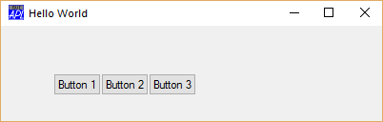
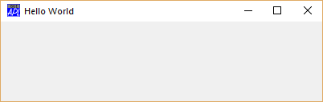
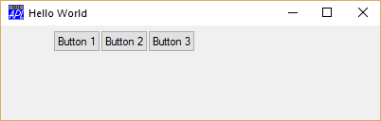
The Parallel Dot (1/2)
F←⎕NEW'Form' (('Caption' 'Hello World') ('Coord' 'Pixel')('Size'(100 400)))
F.(B1 B2 B3)←F.⎕NEW¨{'Button' (('Caption'('Button ',⍕⍵))('Posn'(5+50×0 ⍵)))}¨1 2 3
F.(B1 B2 B3).(Caption Posn) ┌───────────────┬────────────────┬────────────────┐ │┌────────┬────┐│┌────────┬─────┐│┌────────┬─────┐│ ││Button 1│5 55│││Button 2│5 105│││Button 3│5 155││ │└────────┴────┘│└────────┴─────┘│└────────┴─────┘│ └───────────────┴────────────────┴────────────────┘
F.(B1 B2 B3).(Posn[1]←50)

Slide 27
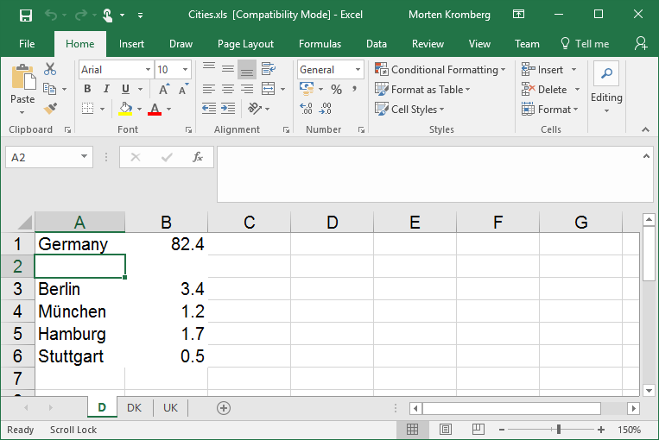
The Parallel Dot (2/2)
XL←⎕NEW 'OleClient' (⊂'ClassName' 'Excel.Application')
cities←XL.Workbooks.Open ⊂'c:\...\cities.xls'
sheets←⌷cities.Sheets ⍝ Sheets collection as an array
sheets.Name ┌─┬──┬──┐ │D│DK│UK│ └─┴──┴──┘
sheets.UsedRange.Value2
┌──────────────────┬───────────────────┬───────────────────────┐ │┌─────────┬──────┐│┌──────────┬──────┐│┌──────────────┬──────┐│ ││Germany │82.4 │││Denmark │5.4 │││United Kingdom│60.2 ││ │├─────────┼──────┤│├──────────┼──────┤│├──────────────┼──────┤│ ││Berlin │3.4 │││Copenhagen│2 │││London │7 ││ │├─────────┼──────┤│├──────────┼──────┤│├──────────────┼──────┤│ ││München │1.2 │││Helsingør │0.03 │││Birmingham │1 ││ │├─────────┼──────┤│└──────────┴──────┘│├──────────────┼──────┤│ ││Stuttgart│0.5 ││ ││Basingstoke │0.1 ││ │└─────────┴──────┘│ │└──────────────┴──────┘│ └──────────────────┴───────────────────┴───────────────────────┘

Slide 28
Futures and Isolates
We have seen that, in Dyalog APL:
ObjectArray.Expression
Evaluates Expression within the context of each item in ObjectArray.
An Isolate is an object within which execution immediately returns a future, while evaluation continues asynchronously.
isolates←isolate.New¨⍬ ⍬ ⍬ ⍝ create 3 empty isolates on local machine time ⋄ delays←isolates.(delay 4) ⋄ time ⋄ +/delays ⋄ time
0.000 ⍝ Time at start of experiment (seconds)
0.049 ⍝ Time when futures assigned to array “delays”
12.023 ⍝ sum of delays (3 isolates - ~4 seconds each)
4.072 ⍝ Time at end of experiment (4 seconds + tax)

Slide 29
Parallel Operator
Monadic operator parallel (∥): f∥ is a derived function which:
creates an isolate containing only the operand function
executes f inside the isolate, immeduately returning a future
(discards the isolate on completion of execution)
Say we wanted to count co-primes below n for n∊1..10
{+/1=⍵∨⍳⍵}¨⍳10 ⍝ count m [1..n] where m GCD n = 1
1 1 2 2 4 2 6 4 6 4
Add parallel to declare that parallel execution of the function is safe & worthwhile:
{+/1=⍵∨⍳⍵}∥¨⍳10 ⍝ co-primes below n, n∊1..10 (using 10 threads)
1 1 2 2 4 2 6 4 6 4
NB: Parallel on pure operands gives us deterministic parallelism.

Slide 30
Extensions Inspired by J / SHARP APL
Dyalog APL has recently added features which evolved in SHARP APL and J:
Rank (⍤): Specify alternatives to mapping functions a scalar-at-a-time
Extended Index Of (⍳): To operate on higher rank arrays
Key (⌸):similar to an SQL group by statement: map function to partitions of right argument defined by keys in left argument

Slide 31
Rank Operator (1 of 2)
mat (x⍤1 0) vec
Addition with left rank 1 (vectors), right rank 0 (scalars)
1 | 2 | 3
4 | 5 | 6
10 | 100
×
10
20
30
400
500
600

Slide 32
Rank Operator (2 of 2)
mat ← 2 2 4 ⍴ ⍳16
1 | 2 | 3 | 4
5 | 6 | 7 | 8
((+⌿ ÷ ≢)⍤2) mat ⍝ avg cols
3 | 4 | 5 | 6
11 | 12 | 13 | 14
9 | 10 | 11 | 12
13 | 14 | 15 | 16
(+⌿ ÷ ≢) mat ⍝ average along 1st dimension
5 | 6 | 7 | 8
9 | 10 | 11 | 12
((+⌿ ÷ ≢)⍤1) mat ⍝ avg rows
2.5 | 6.5
10.5 | 14.5

Slide 33
Extension of ⍳ to Higher Rank
IndexOf ⍳
3 1 4 1 5 9 ⍳ 1 2 3 2 7 1
mat ← 3 4 ⍴ ⍳12
1 | 2 | 3 | 4
5 | 6 | 7 | 8
9 | 10 | 11 | 12
mat ⍳ 5 6 7 8 2

Slide 34
Key Operator
Apply operand function to items corresponding to unique keys.
keys← 'red' 'blue' 'red' 'red' 'blue' values← 10 20 30 40 50
keys {⍺ ⍵}⌸ values ⍝ Return items ┌────┬────────┐ │red │10 30 40│ ├────┼────────┤ │blue│20 50 │ └────┴────────┘
keys {⍺,≢⍵}⌸ values ⍝ Count items ┌────┬─┐ │red │3│ ├────┼─┤ │blue│2│ └────┴─┘

Slide 35
Proposed Operators (1 of 2)
“Stencil” (symbol not selected, one candidate is ⊞) applies function operand to each item of an array – and selected neighbor cells:
⊢ 1 2 3 ⍝ ⊢ is “same”: identity function 1 2 3
(⊢ ⊞ 3) 1 2 3 ⍝ Moving window Size = 3 0 1 2 1 2 3 2 3 0 Neighbors Items
⍝ Now apply a classical ”blur” stencil
({ .25 .5 .25 +.× ⍵} ⊞ 3) 0 10 0 0 10 0
2.5 5 2.5 2.5 5 2.5

Slide 36
John Conway’s Game of Life
Computing the next generation:
Any live cell with fewer than two live neighbours dies, as if caused by under-population.
Any live cell with two or three live neighbours lives on to the next generation.
Any live cell with more than three live neighbours dies, as if by over-population.
Any dead cell with exactly three live neighbours becomes a live cell, as if by reproduction.
life←{↑1 ⍵∨.∧3 4=+/,¯1 0 1∘.⊖¯1 0 1∘.⌽⊂⍵}
life←{↑1 ⍵∨.∧3 4=⊂{+/,⍵} ⊞ 3 3⊢⍵}

Slide 37
John Conway’s Game of Life, contd.
life←{↑1 ⍵∨.∧3 4=⊂{+/,⍵} ⊞ 3 3⊢⍵} ⍝ Stencil Life
⎕←edges←∘.⌈⍨2 1 2 ⍝ Neighbors weighted 2, centre = 1 2 2 2 2 1 2 2 2 2
If there are two or three neighbours for a live cell, the sum of the 3x3 tile around the cell will be 5 or 7. If there are three neighbours for an empty cell (birth), the sum will be 6. So:
⎕←good←5 6 7∊⍨⍳18 ⍝ Index Origin Zero 0 0 0 0 0 1 1 1 0 0 0 0 0 0 0 0 0 0
And finally:
lifeS←{good[{+/,⍵×edges} ⊞ 3 3⊢⍵]}

Slide 38
Neural Networks
APL is a good notation for expressing the math at the core of artificial neural networks. For example, the following function applies a sigmoid function to the output of a collection of sigmoid neurons:
sn←{÷1+*-⍺+.×⍵}
⍺ contains neuron weights (rows are neurons, one col per input) ⍵ is an array of input stimuli (row are inputs, one col per “case”).
This applies the computation as a stencil of size 7 7, to an input matrix:
img←{÷1+*-weights+.×,⍵} ⊞ 7 7⊢⍵}

Slide 39
Proposed Operator @ (2 of 2)
Functional merge operator as alternative to non-functional syntax for ”indexed assignment”:
array[indices]←new_values
Proposed new syntax:
new← (modifier @ selector) old new←new_vals(modifier @ selector) old
Examples:
(42@2) 1 2 3 4 5 ⍝ Merge a value 1 42 3 4 5 2 (×@1 5) 1 2 3 4 5 ⍝ Apply function 2 2 3 4 10 '*'@(∊∘'AEIOU') 'APPLE' ⍝ Selector is Boolean function *PPL*

Slide 40
Proposed Operator @ (2 of 2)
One more example:
0 pco ⍳10 ⍝ 0 pco ←→ not prime
1 0 0 1 0 1 0 1 1 1
'*'@(0∘pco) 10 10⍴⍳100 ⍝ selector is ”where not prime”
* 2 3 * 5 * 7 * * *
11 * 13 * * * 17 * 19 *
* * 23 * * * * * 29 *
31 * * * * * 37 * * *
41 * 43 * * * 47 * * *
* * 53 * * * * * 59 *
61 * * * * * 67 * * *
71 * 73 * * * * * 79 *
* * 83 * * * * * 89 *
* * * * * * 97 * * *

Slide 41
Why is APL Valuable?
Why have a language with +.× or ⌹, we already have BLAS & LAPACK?
A small collection of general operators is suggestive and promotes array thinking, rather than locking users into patterns
APL is a tool of thought which is useful to express ideas on a Whiteboard and leads to new insights into data and algorithms
It is possible to optimise +.× (or call BLAS) and other frequent variations like ∧.=, ∨.∧, and a “decent” job on others
Operators and functions combinations need to be the target of optimisations, as in: Stencil: {+/,wts×⍵} ⊞ 3 3 or Transitive Closure: ∨.∧⍨⍣≡

Slide 42
How to Optimise {⍺,≢⍵}⌸ ?
{⍺,≢⍵}⌸ 1 1 2 2 1 1 2 2 3 3 2 1 4 2 5 3 2
School #1: Avoid array-specific primitive libraries, use standard libraries and let the low-level compiler inline them and optimise them (and etc).
School #2: Hey, but {⍺,≢⍵} means the key and it’s count… This is a histogram.
NB: Dyalog highly optimises bit Booleans, one- and two-byte integers.
You should of course use both approaches for the best results.

Slide 43
Notation as a Tool of Thought
Ken Iverson:
In addition to the executability and universality emphasized in the introduction, a good notation should embody characteristics familiar to any user of mathematical notation:
Ease of expressing constructs arising in problems
Suggestivity
Ability to subordinate detail
Economy
Amenability to formal proofs

Slide 44
Conclusion
(Dyalog) APL allows subject matter experts to use a notation which helps them think
Language extensions like futures and isolates, and the parallel operator, allow users direct control over parallelisation in a way they can understand
Parallelism in solutions is easy to detect and take advantage of in interpreters and compilers
The second 50 years of APL have just begun!

Slide 45
Questions?
More from Roger Hui at 2:15pm: A Tour (de Force) of APL in 16 Expressions
APL workshop here all day tomorrow
Spaces still availble
Other resources:
http://tryapl.org
http://www.dyalog.com
http://dyalog.tv (recordings from APL@50, and more to come)

